Slide 1
Auctions in Financial Markets
INFO 4220 – Networks II: Market Design
Based on Haeringer Ch. 7

Slide 2
Introduction
Auctions are heavily used on financial markets
The most widely used auction in these markets is the double auction
We will discuss how this auction is used in:
  Treasury auctions
  Security trading
  Some initial public offerings

Slide 3
US Treasury Bills/Notes/Bonds
When the US Government needs to borrow money it (typically) sells Treasury bills, notes, and bonds using auctions
Treasury Bill: Maturity is one year or less. Interest is paid at the end along with principal. Typically sold at a discount from their face value.
Treasury Notes: Maturity between two and ten years. Interest paid annually or semiannually
Treasury Bonds: Similar to Treasury Notes, but with maturity of more than 10 years

Slide 4
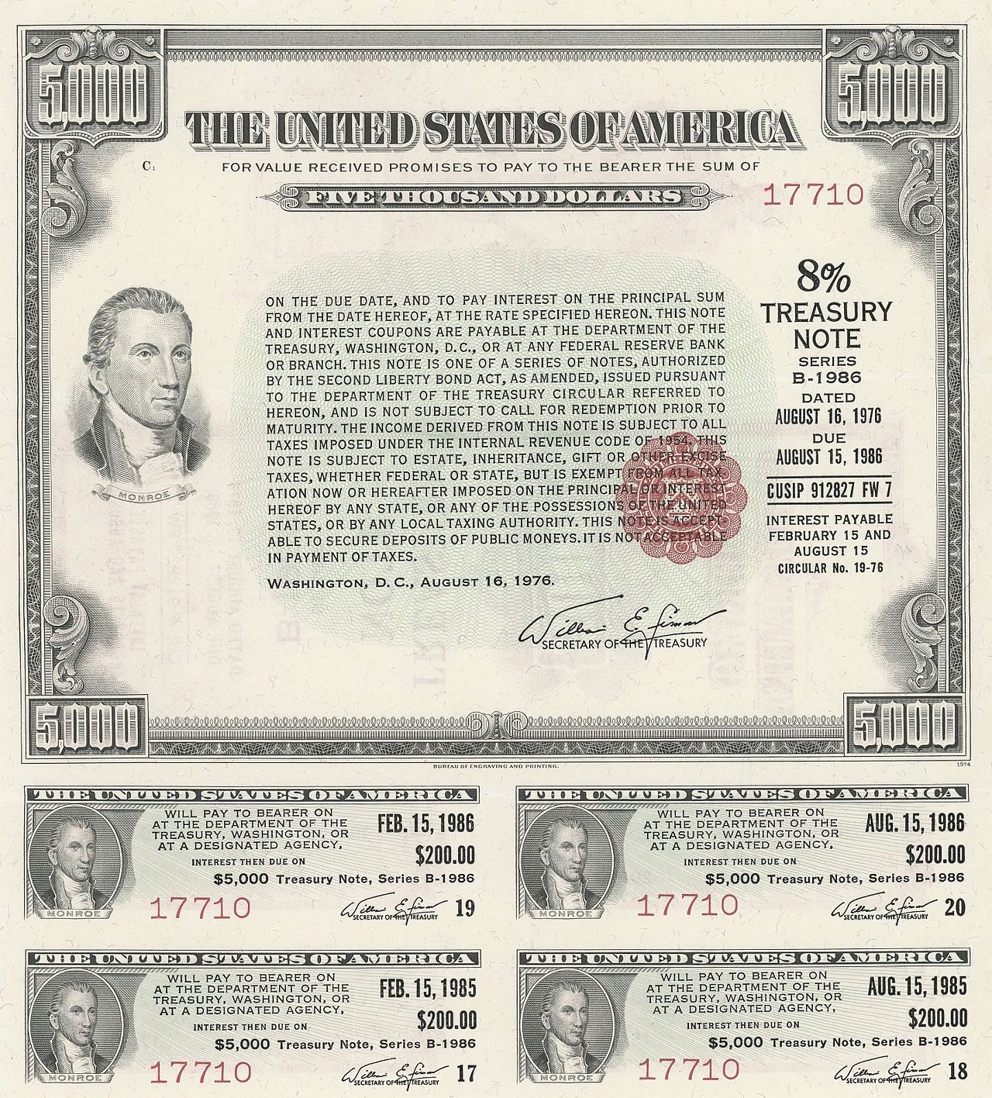
From:
Wikipedia

Slide 5
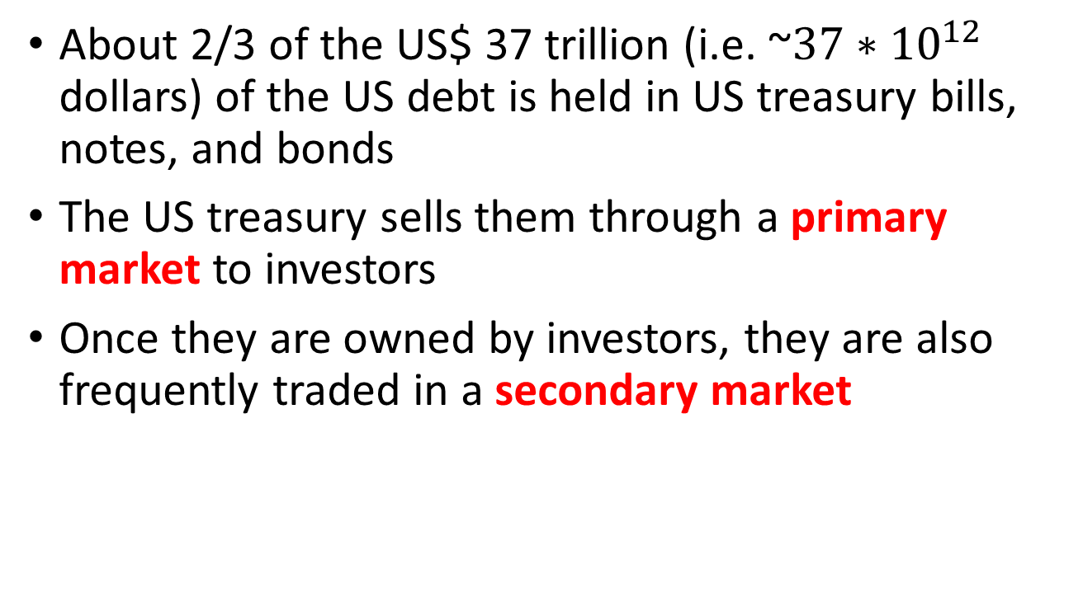
US Treasury Bills/Notes/Bonds
About 2/3 of the US$ 37 trillion (i.e. ~$37∗{10}^{12}$ dollars) of the US debt is held in US treasury bills, notes, and bonds
The US treasury sells them through a primary market to investors
Once they are owned by investors, they are also frequently traded in a secondary market

Slide 6
US Treasury Auctions
When the treasury needs to raise money, it makes a public announcement to hold an auction with the following information:
  Amount the treasury is selling (actually, technically buying)
  Auction date
  Issue date
  Original issue date (if it is a reopening)
  Maturity date
  Terms and condition of the contract
  Definition of who is eligible to participate
  Non-competitive and competitive bidding closing times

Slide 7
The Auction
The objective in the auction is to set at the same time:
  Number of bills/notes/bonds to be issued (how much $)
  Price (interest/yield rate to be paid)
Roles in the auction:
  The treasury is the buyer: It is buying money from investors and would like the lowest price possible (i.e. lowest yield rate)
  Investors are sellers: They sell money to the treasury. They seek the highest possible price
The treasury auction is a uniform price auction: All the bidders are awarded a bill/note/bond with the same yield rate

Slide 8
The Auction Rules
Rules establish two types of buyers:
Primary dealers: Banks or securities brokers-dealers that can trade directly with the federal reserve
  There are currently 24 of them
  They are required to bid “actively” and for a “significant” amount
Other buyers: This includes other institutions (pension funds, insurance companies, investment funds, etc) or anyone (you could participate if you like)

Slide 9
Two-types of Bids
Non-Competitive Bids
Made by small investors and individuals
A bid consists of:
  An amount in dollars
  Bidders are guaranteed the amount they ask for
Non-Competitive bidding closes on the day of the auction at:
  11.00 am for bills
  12.00 pm for notes and bonds

Slide 10
Two-types of Bids
Competitive Bids
Made by primary dealers
A bid consists of:
  A rate (discount rate for bills, yield for coupon-bearing security)
  An amount in dollars
  Bidders are not guaranteed the amount the ask for
Competitive bidding closes on the day of the auction at:
  11.30 am for bills
  1.00 pm for notes and bonds

Slide 11
Treasury Automated Auction Processing System (TAAPS)
Once the auction closes, the TAAPS processes all the bids and determine the auctions’ winning price
Starts with the total amount the Treasury wants to raise:
  Subtract the sum of all non-competitive bids
  Competitive bids are then processed:
    First serve the bidder with the lowest yield
    Subtract the amount proposed from the offering
    Serve the next bidder with the lowest yield
    Repeat until the remaining offering is zero
  Final yield is the yield asked by last bidder(s) served

Slide 12
Example
Public offering: $11 billion
Total non-competitive bids = $ 1 billion
Competitive Bids
Bidder | Yield | Amount
Bidder 1 | 2.998% | $3.5 billion
Bidder 2 | 2.999% | $2.5 billion
Bidder 3 | 3.000% | $3.0 billion
Bidder 4 | 3.000% | $3.0 billion
Bidder 5 | 3.001% | $2.0 billion
Bidder 6 | 3.001% | $1.0 billion

Slide 13
Example
Bidder | Quantity | Remaining Offering
 |  | $11 billion
Non-competitive bids | $1 billion | $10 billion
Bidder 1 (2.998%) | $3.5 billion | $6.5 billion
Bidder 2 (2.999%) | $2.5 billion | $4 billion
For the $4 billion remaining, there is a total of $6 billion in bids at the next lowest rate (3.000%) by bidder 3 and bidder 4
The higher accepted rate, 3.000% is the stop-out rate

Slide 14
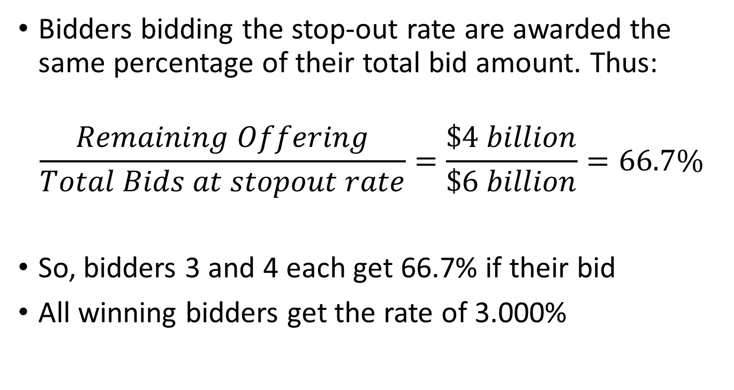
Example
Bidders bidding the stop-out rate are awarded the same percentage of their total bid amount. Thus:
$$\frac{Remaining Offering}{Total Bids at stopout rate}=\frac{\$4 billion}{\$6 billion}=66.7\%$$
So, bidders 3 and 4 each get 66.7% if their bid
All winning bidders get the rate of 3.000%

Slide 15
Example
Final Outcome
Bidder | Yield |  |  | Amount
Non-Competitive |  | $1.0 | $1.0 | 3.000%
Bidder 1 | 2.998% | $3.5 | $3.5 | 3.000%
Bidder 2 | 2.999% | $2.5 | $2.5 | 3.000%
Bidder 3 | 3.000% | $3.0 | $2.0 | 3.000%
Bidder 4 | 3.000% | $3.0 | $2.0 | 3.000%
Bidder 5 | 3.001% | $2.0 | $0.0 | N/A
Bidder 6 | 3.001% | $1.0 | $0.0 | N/A

Slide 16
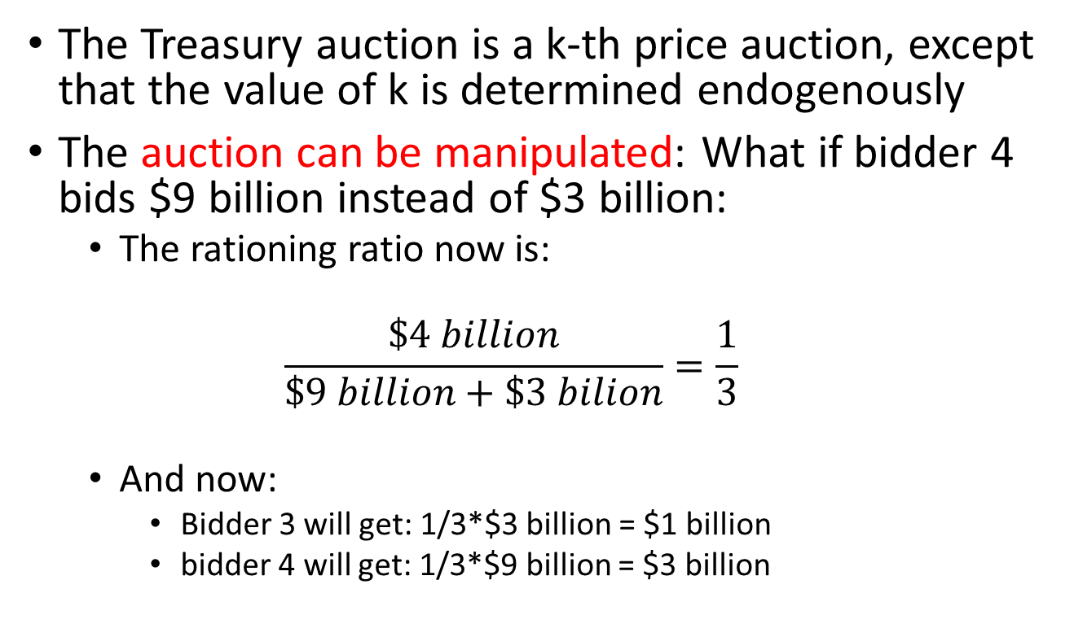
Example
The Treasury auction is a k-th price auction, except that the value of k is determined endogenously
The auction can be manipulated: What if bidder 4 bids $9 billion instead of $3 billion:
  The rationing ratio now is:
  $$\frac{\$4 billion}{\$9 billion+\$3 bilion}=\frac{1}{3}$$
  And now:
    Bidder 3 will get: 1/3*$3 billion = $1 billion
    bidder 4 will get: 1/3*$9 billion = $3 billion

Slide 17
How About the Rate set by the Federal Reserve?
This is a target rate (range) set by the federal reserve at which financial institutions lend money to each other overnight without a collateral
Why do banks need to lend money to each other overnight:
  All banks are required to hold a minimum reserve amount of cash. Those with excess cash one day lend some money to those with a deficit that day
  Or some banks may need money quickly to fund some project and borrow short-term money while they raise the money the need

Slide 18
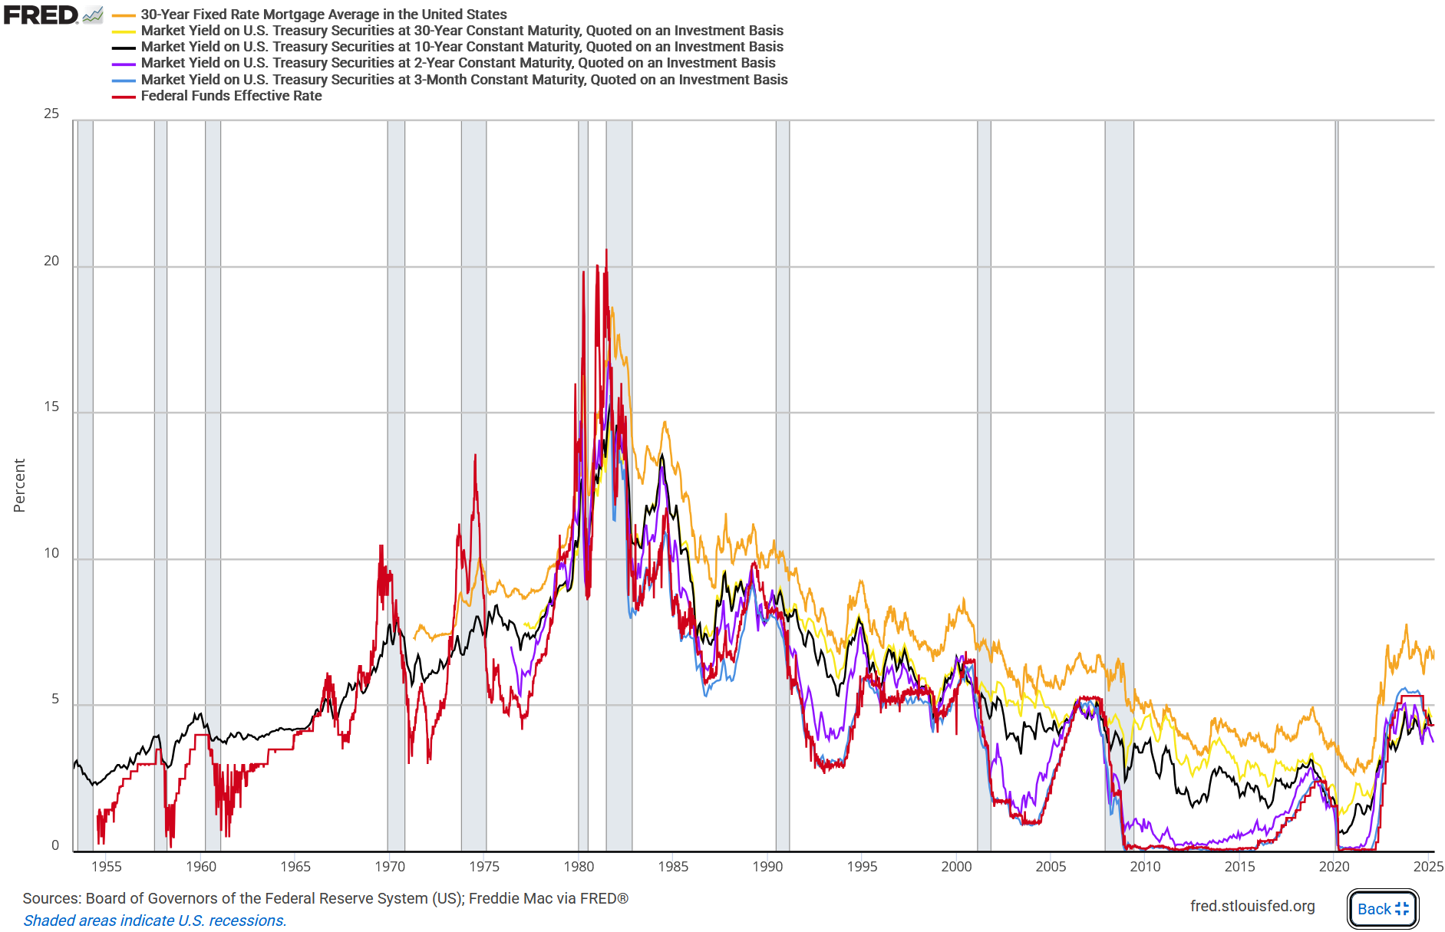
Federal Funds Rate vs Treasury Bills, Bonds, and Notes
From https://fred.stlouisfed.org/graph/?g=NkLj

Slide 19
Double Auctions
A double auction is an auction where both the buyers and the sellers bid
Buyers and sellers submit (bids) that specify:
  The price at which they are willing to buy/sell (optional)
  The quantity they are willing to buy/sell
An order that specifies a price is called a “limit order”, otherwise is called a “market order”

Slide 20
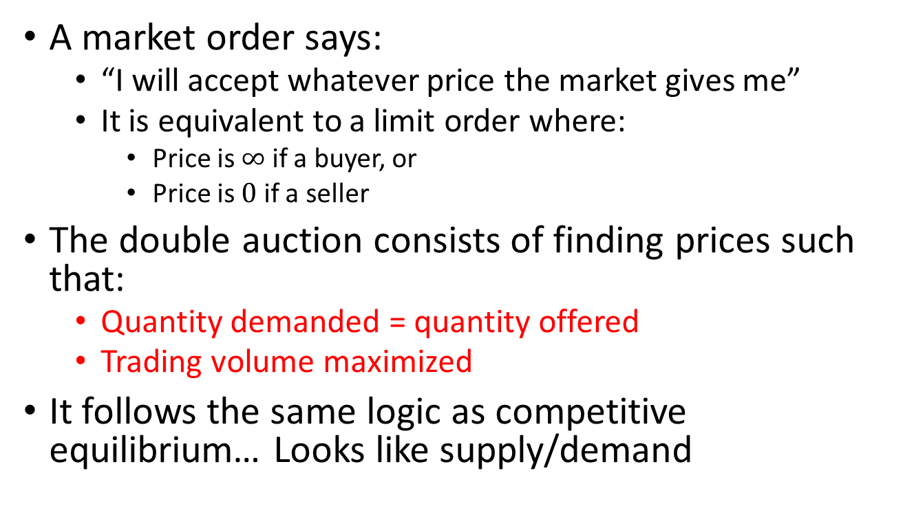
Double Auctions
A market order says:
  “I will accept whatever price the market gives me”
  It is equivalent to a limit order where:
    Price is $∞$ if a buyer, or
    Price is $0$ if a seller
The double auction consists of finding prices such that:
  Quantity demanded = quantity offered
  Trading volume maximized
It follows the same logic as competitive equilibrium… Looks like supply/demand

Slide 21
Double Auctions
Traditionally, the price proposed by:
  A seller is called and ask
  A buyer is called a bid
In the Treasury Auctions we discussed:
  The primary dealers submit limit orders (ask)
  Non-competitive bidders submit market orders (ask)
  The Treasury submits a market order (bid)

Slide 22
Example
Trader | Bid | Quantity | Cumulative Demand
Alice | Market | 4 | 4
Bob | $8 | 6 | 10
Chris | $6 | 4 | 14
Denis | $4 | 4 | 18
For a buyer, a bid of price = 8 and quantity = 6 means:
  Buyer is willing to buy up to 6 units as long as the price is at most 8
  If the price is more than 8, then the buyer doesn’t buy anything
  If price is exactly 8, the buyer is indifferent between buying any quantity between 0 and 6
A market bid for a quantity of 4 means the buyer will buy 4 units at any price

Slide 23
Example
Trader | Ask | Quantity | Cumulative Supply
Gina | Market | 3 | 3
Henry | $4 | 5 | 8
John | $6 | 4 | 12
Mary | $10 | 4 | 16
For a seller, an ask of = 4 and quantity = 5 means:
  Seller is willing to sell up to 5 units as long as the price is at least 4
  If the price is less than 4, then the seller doesn’t sell anything
  If price is exactly 4, seller is indifferent with selling any quantity between 0 and 5
A market ask for a quantity of 3 means the seller will sell 3 units at any price

Slide 24
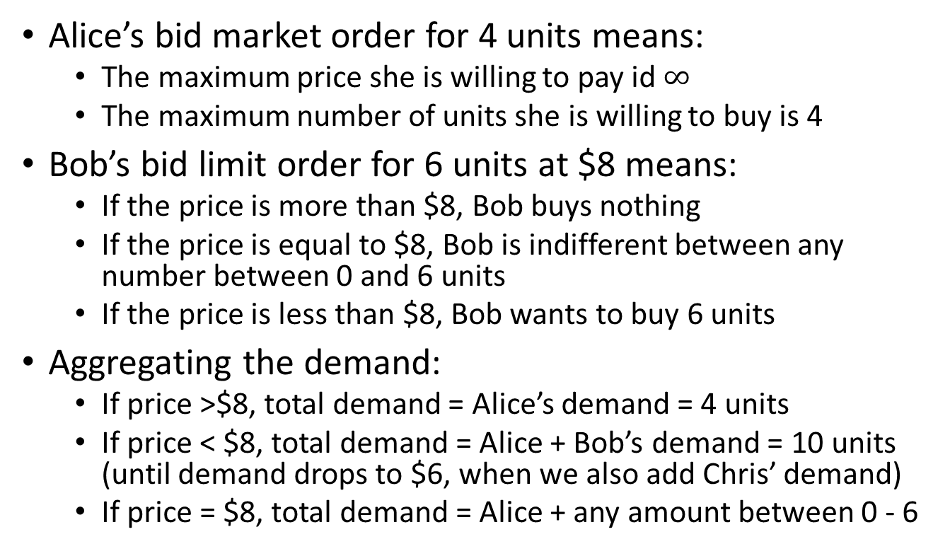
Example
Alice’s bid market order for 4 units means:
  The maximum price she is willing to pay id $∞$
  The maximum number of units she is willing to buy is 4
Bob’s bid limit order for 6 units at $8 means:
  If the price is more than $8, Bob buys nothing
  If the price is equal to $8, Bob is indifferent between any number between 0 and 6 units
  If the price is less than $8, Bob wants to buy 6 units
Aggregating the demand:
  If price >$8, total demand = Alice’s demand = 4 units
  If price < $8, total demand = Alice + Bob’s demand = 10 units (until demand drops to $6, when we also add Chris’ demand)
  If price = $8, total demand = Alice + any amount between 0 - 6

Slide 25
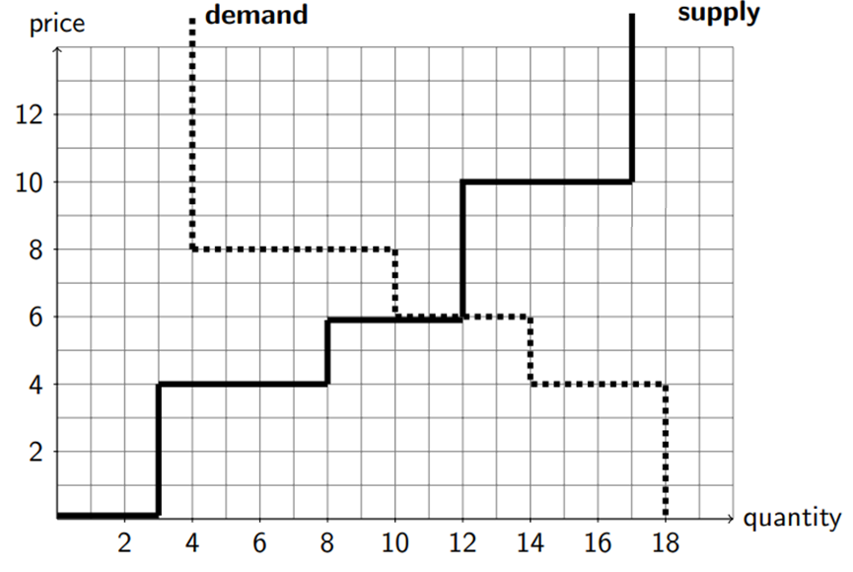

Slide 26
Example
Price | Demand | Supply
$4 | 18 | 8
$6 | 14 | 12
$8 | 10 | 12
$10 | 4 | 16
At $6 the demand and supply cross:
  The buyer who bid strictly more than $6 are served (Alice and Bob): Quantity = 10
  The sellers who ask strictly less than $6 are served (Gina and Henry): Quantity = 8
  John still has 2 more units to sell. Those are sold to Chris, whose demand is partially filled (he wanted up to 4 units at a price of $6)

Slide 27
Surplus in Double Auction
In the double auction the surplus is maximized:
  If I bid $10 and I purchase at $7, then my surplus is $3
  If I ask $6 and I sell at $7, then my surplus is $1
  For a buyer not buying or a seller not selling, the surplus is 0
  Total surplus = sum of the surplus of buyers and sellers

Slide 28
Initial Public Offering (IPO)
And IPO is when a private company goes public:
  Its shares are listed by an exchange and anyone can buy or sell them
The most common way is to use the service of one or more investment banks, called the underwriters
  The underwriters set price targets for the shares
  The underwriters approach investors and brokers for the initial sale of the shares
The risks of mispricing is important:
  Overpricing: Facebook
  Underpricing: theglobe.com

Slide 29
Theglobe.com
Founded in 1995 by Todd Krizelman and Stephan Paternot in their Cornell dorm room
Allowed people to set up webpages
Went public on Nov 13, 1998 at an initial price of $9
In the first day of trading the price went up to $97 and closed at $63.50
In less than two years the price was down to $2

Slide 30
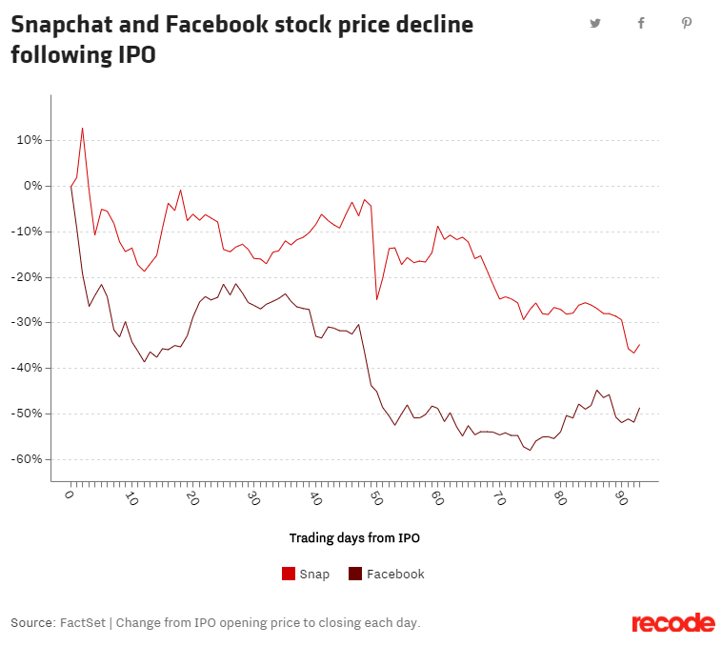

Slide 31
Using Auctions for IPOs
Instead of using underwriters for IPOs, some firms used an auction instead
Most famous case if Google’s IPO
With an auction the risk of mispricing is lower
  Auction are price discovery mechanisms
Investment banks do not like this method
  It takes away their underwriting business

Slide 32
Take Away
The double auction is the main mechanism used in financial markets
The double auction works as a supply-demand equilibrium
Buyers and sellers send:
  Market orders (just a quantity)
  Limit order (a quantity and a price)
The price proposed by a sellers is the ask
The price proposed by the buyers are bids

Slide 33
Take Away
In a US Treasury Auction
  The Treasury is “buying” cash from investors: It submits a market order
  Primary dealers (a small set of large investors that met certain criteria) are allowed to submit limit order. These are called competitive bids
  The rest of us can submit market orders. These are called non-competitive bids
Auctions are also used on some IPOs

